Slide 1

Technical Presentation
Lexical Analysis and Token Specification using LEX
By Supervisor
Prartana T Dr G Michael
192421099 Professor
Department of CSE

Slide 2
Lexical Analysis & Tokens
Lexical Analysis
First phase of the compiler.
Reads the source program.
Converts characters into tokens.
Removes white spaces and comments.
Passes tokens to the syntax analyzer.
Flow
Source Code
↓
Lexical Analyzer
↓
Tokens
↓
Syntax Analyzer

Slide 3
Token Specification using LEX Token specification defines rules for identifying tokens. LEX uses Regular Expressions (Regex). Each pattern is linked with an action. Matching input is converted into tokens automatically.
Pattern | Token
[0-9]+ | Number
[a-zA-Z]+ | Identifier
if | Keyword
[+\-*/] | Operator

Slide 4
Working of LEX
Read the source code.
Compare input with Regex patterns.
Identify matching token.
Generate tokens.
Send tokens to the parser.
Example
Input:
int x = 10;
Output:
int → Keyword
x → Identifier
= → Operator
10 → Number

Slide 5
Disadvantages >>Performs only lexical analysis. >>Complex Regex can be difficult. >>Cannot detect syntax errors. >>Requires proper rule definitions.
Advantages
>>Automatic lexical analyzer generation.
>>Faster token recognition.
>>Easy to maintain.
>>Detects lexical errors.
>>Reduces manual coding effort.

Slide 6
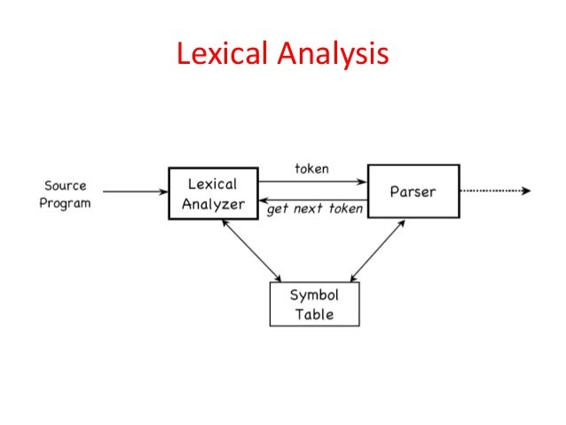
Importance of Token Specification using LEX
Improves compiler efficiency.
Ensures accurate token recognition.
Simplifies compiler development.
Reduces development time.
Supports reliable parsing.

Slide 7
Thank You

Slide 8


